Slide 1

LECTURE 5: Domain Modeling
Liang Xiao

Slide 2
Topics
Identifying Concepts
Concept Attributes
Concept Associations
Contracts: Preconditions and Postconditions

Slide 3
Domain Modeling
Why? —The goal of domain modeling is to understand how system-to-be will work
  Requirements analysis determined how users will interact with system-to-be (external behavior)
  Domain modeling determines how elements of system-to-be interact (internal behavior) to produce the external behavior
How? —We do domain modeling based on sources:
  Knowledge of how system-to-be is supposed to behave (from requirements analysis, e.g., use cases)
  Studying the work domain (or, problem domain)
  Knowledge base of software designs
  Developer’s past experience with software design

Slide 4
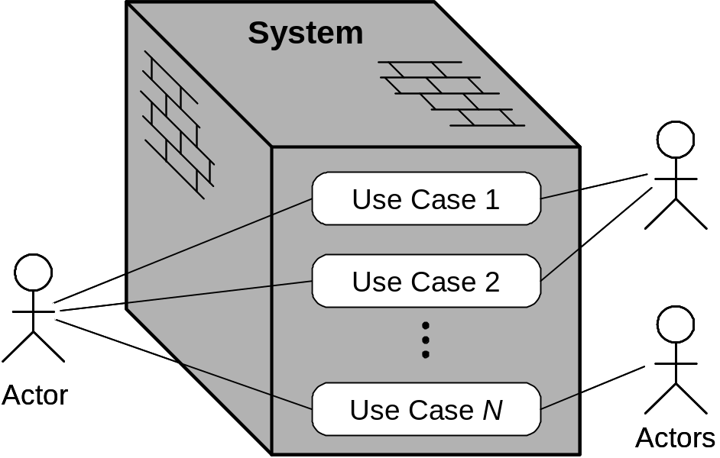
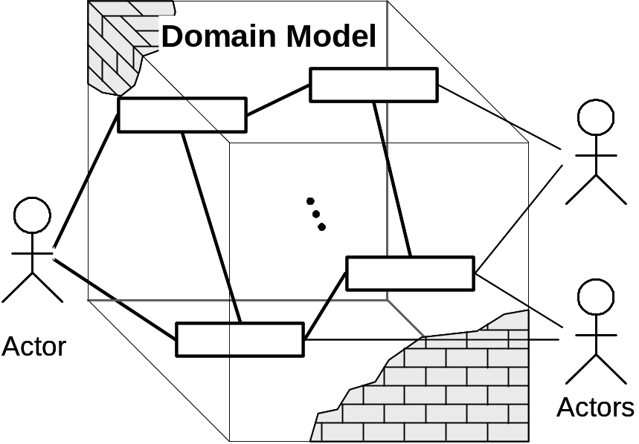
Use Cases vs. Domain Model
In domain analysis, we consider the system as a “transparent box”: need to peer inside the box to uncover the constituent entities and their (static) relations that make the black box behave as described by its use cases
In use case analysis, we consider the system as a “black box”
(a)
(b)

Slide 5
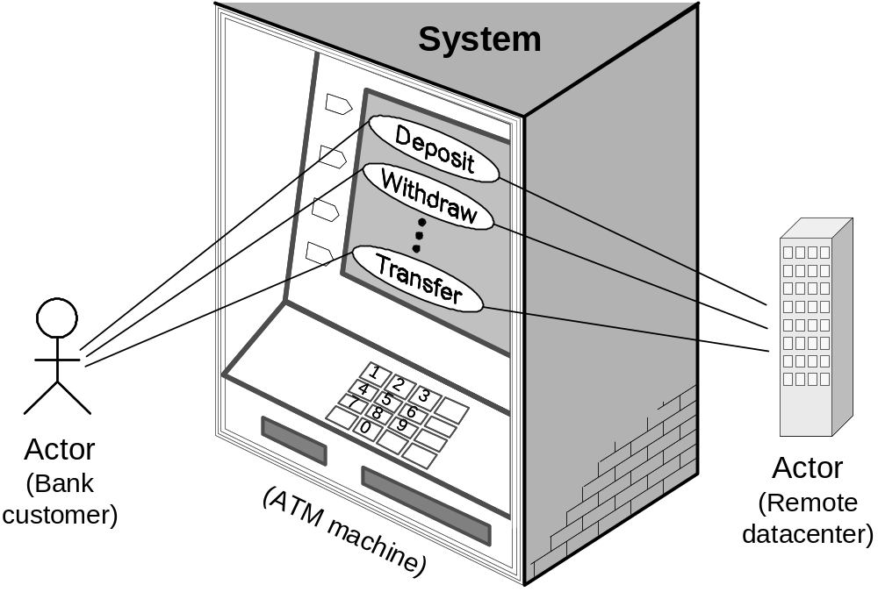
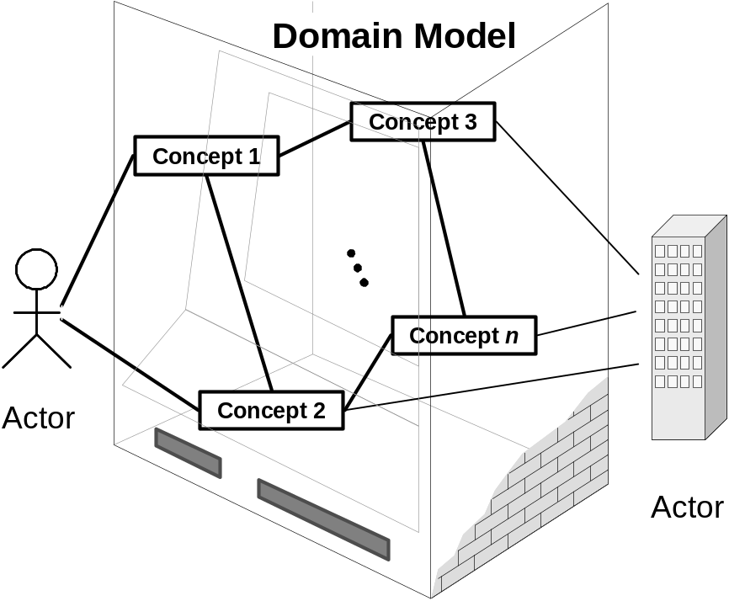
Example: ATM Machine
(b)
(a)

Slide 6
Analysis vs. Design
“Domain modelling/analysis”
Analysis phase is concerned with the “what” aspect—identifying what workers need to be hired and what things acquired.
Design deals with the “how” aspect—how these workers interact with each other and with the things at their workplace to accomplish their share in the process of fulfilling a service request.
No clear boundary between the “what” and the “how.”

Slide 7
Identifying Concepts
We hire workers with appropriate expertise and acquire things they will work with.
Start by listing the positions or, better, responsibilities, for which we are hiring.
Identify the responsibilities by examining the use case scenarios and system sequence diagrams.
  We need a worker to verify whether or not the key entered by the user is valid, so we title this position KeyChecker
  We also need a worker to know (memorize, or keep track of) the collection of valid keys, so we advertise an opening for KeyStorage
  Further, to operate the lock and the light/switch, we come up with LockOperator and LightOperator positions, respectively
  Concept name is always a noun phrase

Slide 8
A useful strategy: start from “boundary” of the system, or concepts that handle interactions between actors and the system

Slide 9
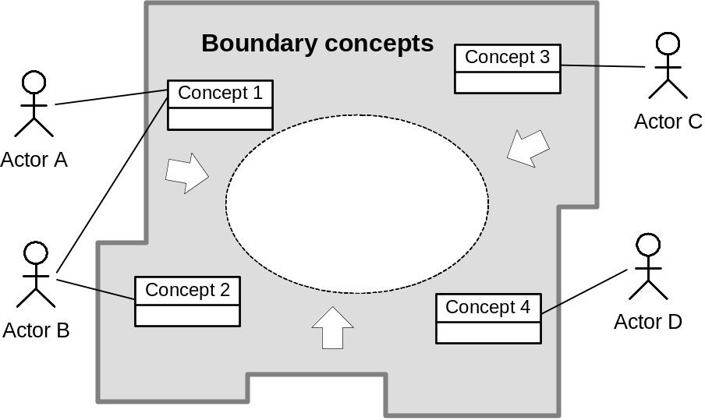
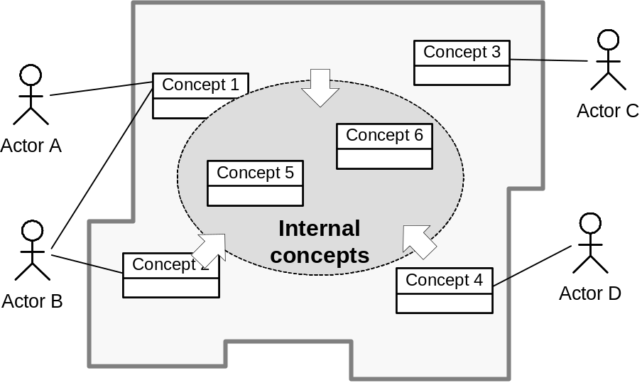
Building Domain Model from Use Cases
Step 1: Identifying the boundary concepts that interact directly with the actors
Step 2: Identifying the internal concepts
The boundary object collects the information from the actor and translates it into a form that can be used by “internal” objects. As well, the boundary object may translate the information in the other direction, from “internal” objects to a format suitable for an actor

Slide 10
The use of a “Controller”
Organizations are often fronted by a point-of-contact person. A common pattern is to have a specialized worker to take orders from the clients and orchestrate the workings of the workers inside the system. This type of object is known as Controller.

Slide 11
Use Case 1: Unlock
Use Case UC-1: |  |  | Unlock
Related Requirements: |  |  | REQ1, REQ3, REQ4, and REQ5 stated in Table 2-1
Initiating Actor: |  |  | Any of: Tenant, Landlord
Actor’s Goal: |  |  | To disarm the lock and enter, and get space lighted up automatically.
Participating Actors: |  |  | LockDevice, LightSwitch, Timer
Preconditions: |  |  | • The set of valid keys stored in the system database is non-empty. • The system displays the menu of available functions; at the door keypad the menu choices are “Lock” and “Unlock.”
Postconditions: |  |  | The auto-lock timer has started countdown from autoLockInterval.
Flow of Events for Main Success Scenario:
→ | 1. | Tenant/Landlord arrives at the door and selects the menu item “Unlock”
 | 2. | include::AuthenticateUser (UC-7)
← | 3. | System (a) signals to the Tenant/Landlord the lock status, e.g., “disarmed,” (b) signals to LockDevice to disarm the lock, and (c) signals to LightSwitch to turn the light on
← | 4. | System signals to the Timer to start the auto-lock timer countdown
→ | 5. | Tenant/Landlord opens the door, enters the home [and shuts the door and locks]

Slide 12
Extracting the Responsibilities
Responsibility Description | Type | Concept Name
Coordinate actions of all concepts associated with a use case, a logical grouping of use cases, or the entire system and delegate the work to other concepts. | D | Controller
Container for user’s authentication data, such as pass-code, timestamp, door identification, etc. | K | Key
Verify whether or not the key-code entered by the user is valid. | D | KeyChecker
Container for the collection of valid keys associated with doors and users. | K | KeyStorage
Operate the lock device to armed/disarmed positions. | D | LockOperator
Operate the light switch to turn the light on/off. | D | LightOperator
Operate the alarm bell to signal possible break-ins. | D | AlarmOperator
Block the input to deny more attempts if too many unsuccessful attempts. | D | Controller
Log all interactions with the system in persistent storage. | D | Logger
Worker titles (concept names) and responsibilities assigned to them.
Types “D” and “K” denote doing vs. knowing responsibilities, respectively.

Slide 13
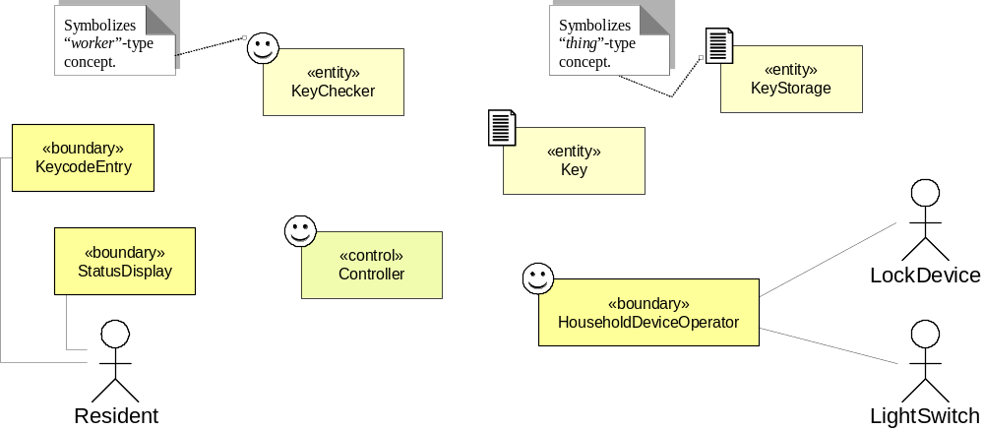
Domain Model (1): subsystem #1 of safe home access
A smiley face or a document symbol added to distinguish “worker” vs. “thing” concepts. Workers get assigned mainly doing responsibilities, while things get assigned mainly knowing responsibilities, e.g. KeyChecker vs. KeyStorage (KeycodeEntry & StatusDisplay combine both so left unlabeled)
Objects at analysis time have no methods/operations. It is the task of design to determine how the behavior of the system is to be realized in terms of the behavior of objects

Slide 14
Classifying concepts into the <<boundary>>, <<control>>, and <<entity>>
At first, Key may be considered a <<boundary>> because keys are exchanged between the actors and the system. On the other hand, keys are also stored in KeyStorage – also contains other information, such as timestamp and the door identifier. Only pass-codes identifying the actors are exchanged between the actors and the system (concept: KeycodeEntry) and this information is transferred to the Key concept.

Slide 15
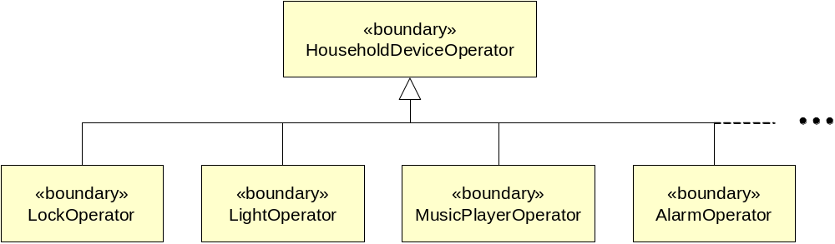
Domain Model (2)
Generalization of the concept HouseholdDeviceOperator (Domain Model (1)) as a conceptual superclass obtained by identifying commonality among the concepts that operate different household devices

Slide 16
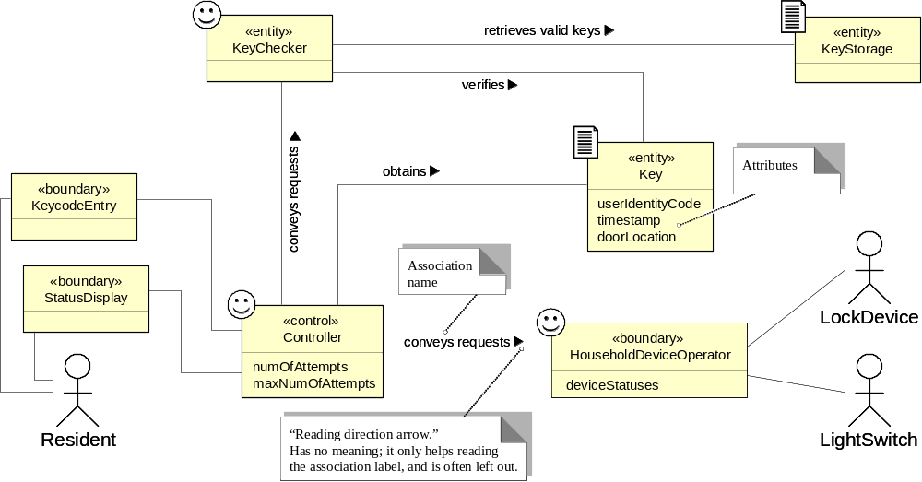
Domain Model (3a)
Domain model for UC-1: Unlock
Associations: who needs to work together, not how they work together
Concept pair | Association description | Association name

Slide 17
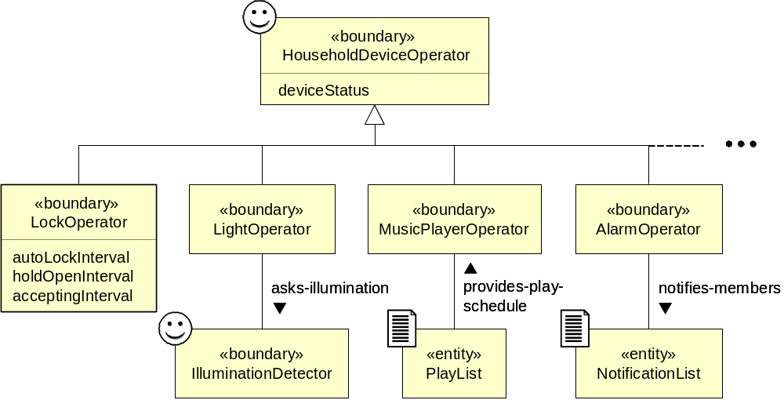
Domain Model (3b)

Slide 18
Use Case 5: Inspect Access History
Use Case UC-5: |  |  | Inspect Access History
Related Requirements: |  |  | REQ8 and REQ9 stated in Table 2-1
Initiating Actor: |  |  | Any of: Tenant, Landlord
Actor’s Goal: |  |  | To examine the access history for a particular door.
Participating Actors: |  |  | Database, Landlord
Preconditions: |  |  | Tenant/Landlord is currently logged in the system and is shown a hyperlink “View Access History.”
Postconditions: |  |  | None.
Flow of Events for Main Success Scenario:
→ | 1. | Tenant/Landlord clicks the hyperlink “View Access History”
← | 2. | System prompts for the search criteria (e.g., time frame, door location, actor role, event type, etc.) or “Show all”
→ | 3. | Tenant/Landlord specifies the search criteria and submits
← | 4. | System prepares a database query that best matches the actor’s search criteria and retrieves the records from the Database
→ | 5. | Database returns the matching records
← | 6. | System (a) additionally filters the retrieved records to match the actor’s search criteria; (b) renders the remaining records for display; and (c) shows the result for Tenant/Landlord’s consideration
→ | 7. | Tenant/Landlord browses, selects “interesting” records (if any), and requests further investigation (with an accompanying complaint description)
← | 8. | System (a) displays only the selected records and confirms the request; (b) archives the request in the Database and assigns it a tracking number; (c) notifies Landlord about the request; and (d) informs Tenant/Landlord about the tracking number

Slide 19
Extracting the Responsibilities
Responsibility Description | Type | Concept Name
Rs1. Coordinate actions of concepts associated with this use case and delegate the work to other concepts. | D | Controller
Rs2. Form specifying the search parameters for database log retrieval (from UC-5, Step 2). | K | Search Request
Rs3. Render the retrieved records into an HTML document for sending to actor’s Web browser for display. | D | Page Maker
Rs4. HTML document that shows the actor the current context, what actions can be done, and outcomes of the previous actions. | K | Interface Page
Rs5. Prepare a database query that best matches the actor’s search criteria and retrieve the records from the database (from UC-5, Step 4). | D | Database Connection
Rs6. Filter the retrieved records to match the actor’s search criteria (from UC-5, Step 6). | D | Postprocessor
Rs7. List of “interesting” records for further investigation, complaint description, and the tracking number. | K | Investigation Request
Rs8. Archive the request in the database and assign it a tracking number (from UC-5, Step 8). | D | Archiver
Rs9. Notify Landlord about the request (from UC-5, Step 8). | D | Notifier

Slide 20
Associations
Associations describe who needs to work together and why, not how they work together

Slide 21
Extracting the Associations
Concept pair | Association description | Association name
Controller ↔ Page Maker | Controller passes requests to Page Maker and receives back pages prepared for displaying | conveys requests
Page Maker ↔ Database Connection | Database Connection passes the retrieved data to Page Maker to render them for display | provides data
Page Maker ↔ Interface Page | Page Maker prepares the Interface Page | prepares
Controller ↔ Database Connection | Controller passes search requests to Database Connection | conveys requests
Controller ↔ Archiver | Controller passes a list of “interesting” records and complaint description to Archiver, which assigns the tracking number and creates Investigation Request | conveys requests
Archiver ↔ Investigation Request | Archiver generates Investigation Request | generates
Archiver ↔ Database Connection | Archiver requests Database Connection to store investigation requests into the database | requests save
Archiver ↔ Notifier | Archiver requests Notifier to notify Landlord about investigation requests | requests notify

Slide 22
Extracting the Attributes
Concept | Attributes | Attribute Description
Search Request | user’s identity | Used to determine the actor’s credentials, which in turn specify what kind of data this actor is authorized to view.
 | search parameters | Time frame, actor role, door location, event type (unlock, lock, power failure, etc.).
Postprocessor | search parameters | Copied from search request; needed to Filter the retrieved records to match the actor’s search criteria.
Investigation Request | records list | List of “interesting” records selected for further investigation.
 | complaint description | Describes the actor’s suspicions about the selected access records.
 | tracking number | Allows tracking of the investigation status.
Archiver | current tracking number | Needed to assign a tracking number to complaints and requests.
Notifier | contact information | Contact information of the Landlord who accepts complaints and requests for further investigation.

Slide 23
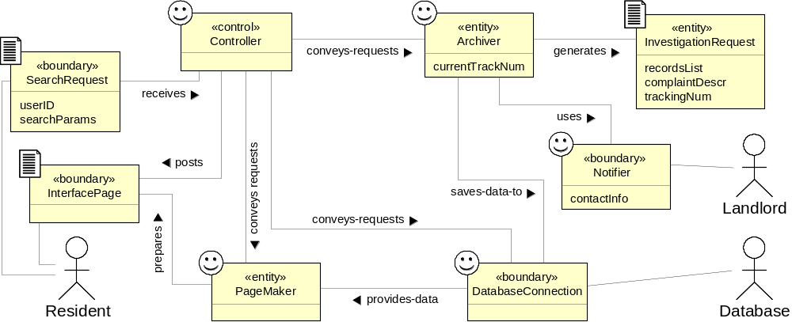
Domain Model (4)
Domain model
for UC-5: Inspect Access History

Slide 24
The traceability property
Use case scenarios feed into → system sequence diagrams, which in turn feed into → domain model

Slide 25
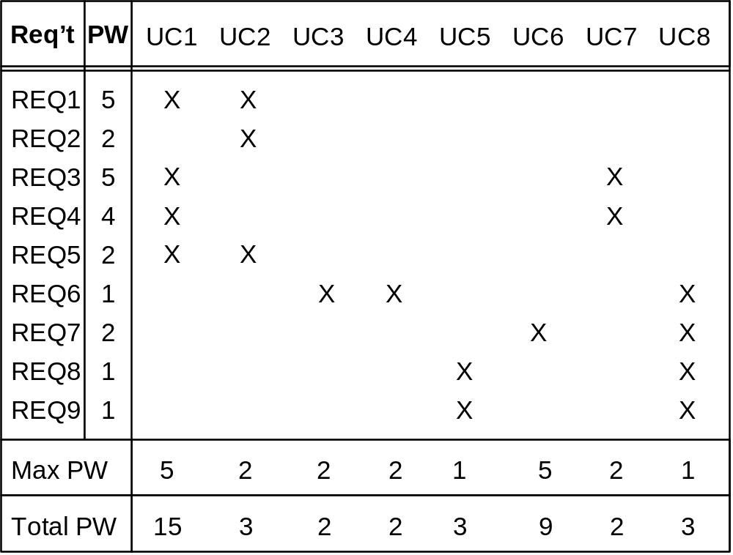
Traceability Matrix (1)
Mapping: System requirements to Use cases
UC1: Unlock
UC2: Lock
UC3: AddUser
UC4: RemoveUser
UC5: InspectAccessHistory
UC6: SetDevicePrefs
UC7: AuthenticateUser
UC8: Login
REQ1: Keep door locked and auto-lock
REQ2: Lock when “LOCK” pressed
REQ3: Unlock when valid key provided
REQ4: Allow mistakes but prevent dictionary attacks
REQ5: Maintain a history log
REQ6: Adding/removing users at runtime
REQ7: Configuring the device activation preferences
REQ8: Inspecting the access history
REQ9: Filing inquiries

Slide 26
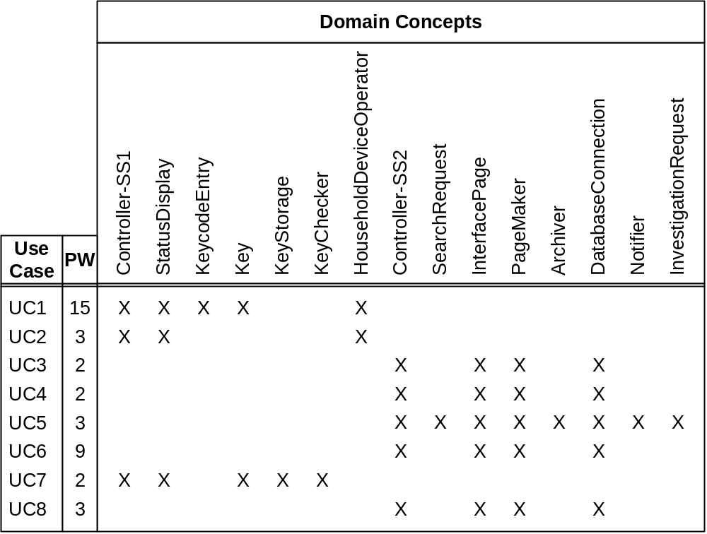
Traceability Matrix (2)
Mapping: Use cases to Domain model
UC1: Unlock
UC2: Lock
UC3: AddUser
UC4: RemoveUser
UC5: InspectAccessHistory
UC6: SetDevicePrefs
UC7: AuthenticateUser
UC8: Login

Slide 27
Contracts:
Preconditions and Postconditions
Operation | Unlock
Preconditions | • set of valid keys known to the system is not empty
 | • numOfAttempts < maxNumOfAttempts
 | • numOfAttempts = 0, for the first attempt of the current user
Postconditions | • numOfAttempts = 0, if the entered Key ∈ Valid keys
 | • current instance of the Key object is archived and destroyed
Operation | Lock
Preconditions | None (that is, none worth mentioning)
Postconditions | • lockStatus = “armed”, and
 | • lightStatus remains unchanged (see text for discussion)

Slide 28
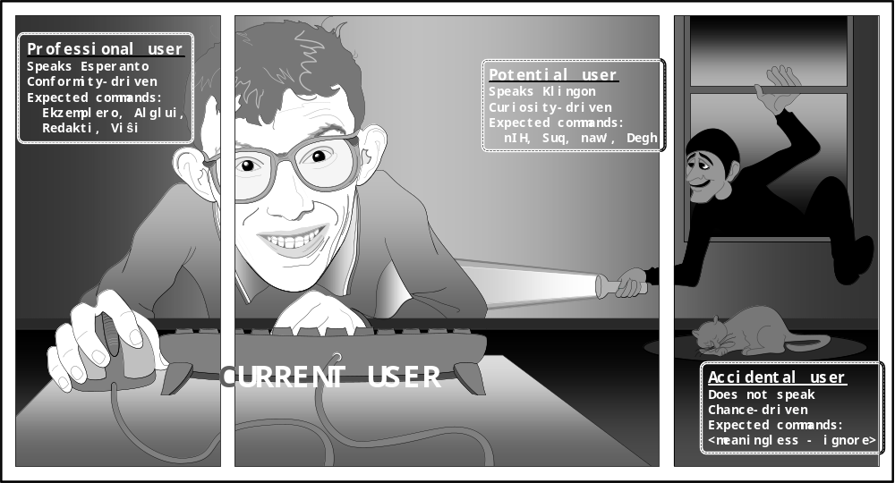
Domain Analysis:
Looking from Inside Out

Slide 29

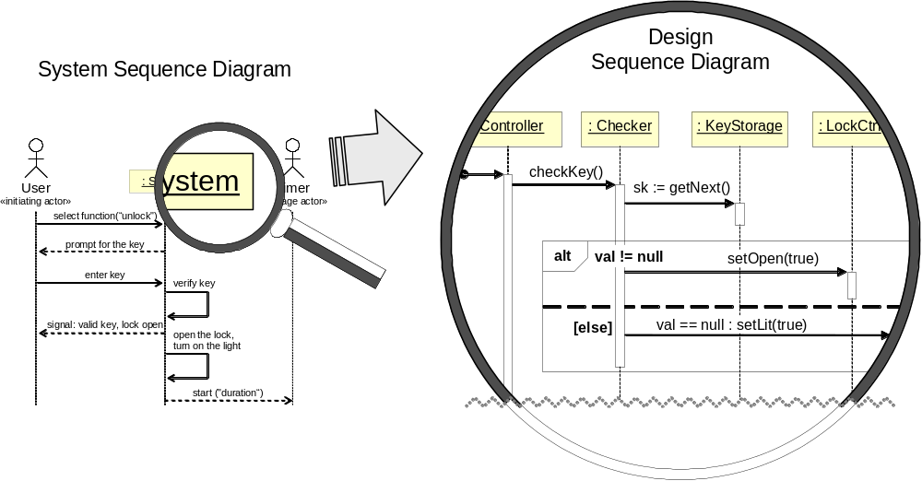
Design: Object Interactions

Slide 30
The doing (D) and knowing (K) responsibilities and their assigned concepts
Responsibility Description | Type | Concept Name
Player’s account contains the available fantasy money currently not invested into stocks (called account balance). Other potential info includes Player’s historic performance and trading patterns. | K | InvestmentAcct
A record of all stocks that Player currently owns, along with the quantity of shares for each stock, latest stock price, current portfolio value, etc. | K | Portfolio
Update player’s account and portfolio info after transactions and fees. Adjust the portfolio value based on real-world market movements. | D | AcctHandler
Watch periodically real-world market movements for all the stocks owned by any player in the system. | D | MarketWatcher
Fetch selected current stock prices by querying StockReportingWebsite. | D | StockRetriever
HTML document returned by StockReportingWebsite, containing the current stock prices and the number of available shares. | K | StockPricesDoc
Extract stock prices and other info from HTML doc StockPricesDoc. | D | StockExtractor
Information about a traded stock, such as ticker symbol, trading price, etc. | K | StockInfo
Log history of all trading transactions, including the details such as transaction type, time, date, player ID, stocks transacted, etc. | D | Logger

Slide 31
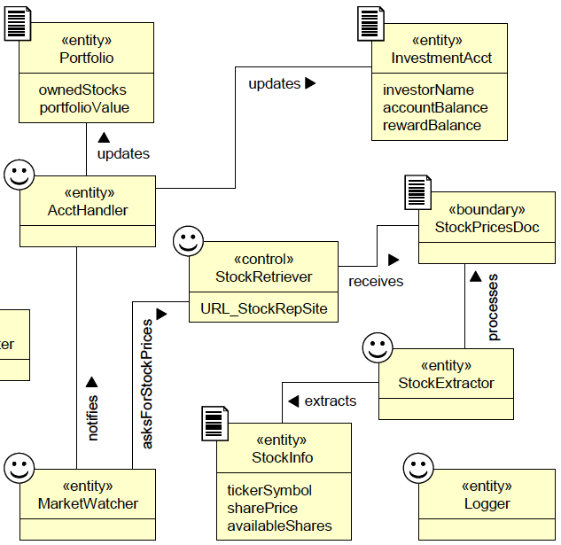

Slide 32
The doing (D) and knowing (K) responsibilities and their assigned concepts
Responsibility Description | Type | Concept Name
Player’s account contains the available fantasy money currently not invested into stocks (called account balance). Other potential info includes Player’s historic performance and trading patterns. | K | InvestmentAcct
A record of all stocks that Player currently owns, along with the quantity of shares for each stock, latest stock price, current portfolio value, etc. | K | Portfolio
Update player’s account and portfolio info after transactions and fees. Adjust the portfolio value based on real-world market movements. | D | AcctHandler
Watch periodically real-world market movements for all the stocks owned by any player in the system. | D | MarketWatcher
Fetch selected current stock prices by querying StockReportingWebsite. | D | StockRetriever
HTML document returned by StockReportingWebsite, containing the current stock prices and the number of available shares. | K | StockPricesDoc
Extract stock prices and other info from HTML doc StockPricesDoc. | D | StockExtractor
Information about a traded stock, such as ticker symbol, trading price, etc. | K | StockInfo
Log history of all trading transactions, including the details such as transaction type, time, date, player ID, stocks transacted, etc. | D | Logger

Slide 34
The doing (D) and knowing (K) responsibilities and their assigned concepts
Responsibility Description | Type | Concept Name
Player’s account contains the available fantasy money currently not invested into stocks (called account balance). Other potential info includes Player’s historic performance and trading patterns. | K | InvestmentAcct
A record of all stocks that Player currently owns, along with the quantity of shares for each stock, latest stock price, current portfolio value, etc. | K | Portfolio
Update player’s account and portfolio info after transactions and fees. Adjust the portfolio value based on real-world market movements. | D | AcctHandler
Watch periodically real-world market movements for all the stocks owned by any player in the system. | D | MarketWatcher
Fetch selected current stock prices by querying StockReportingWebsite. | D | StockRetriever
HTML document returned by StockReportingWebsite, containing the current stock prices and the number of available shares. | K | StockPricesDoc
Extract stock prices and other info from HTML doc StockPricesDoc. | D | StockExtractor
Information about a traded stock, such as ticker symbol, trading price, etc. | K | StockInfo
Log history of all trading transactions, including the details such as transaction type, time, date, player ID, stocks transacted, etc. | D | Logger

